Slide 1
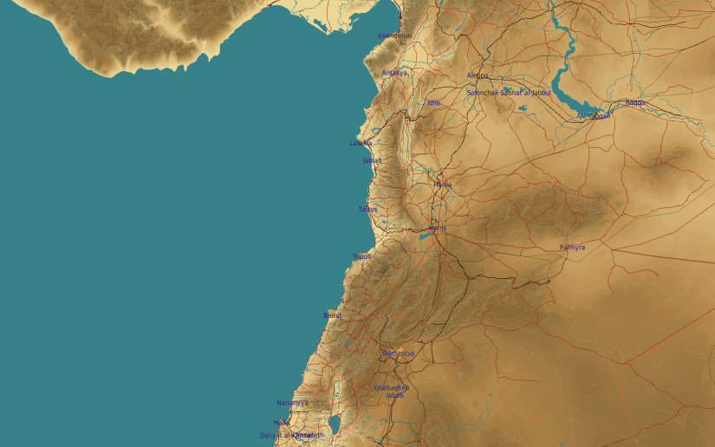
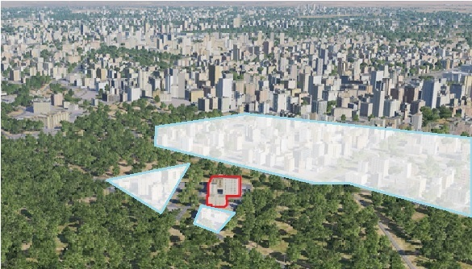
OPARTGT094 Syrian Intelligence Internet Agency
N
94
DESCRIPTION OF THE DESIRED POINTS OF IMPACT WITH WPN TYPE:
OPARTGT094A – Internet Agency Centre
DPI 1 N33 30.849 E036 16.059/2276ft/(2000 Ibs bomb)
OPARTGT094B – Analyst Centre
DPI 2 N33 30.840 E036 16.080/2273ft/(1000 Ibs bomb)
OPARTGT094C – Server Halls
DPI 3 N33 30.856 E036 16.073/2273ft/(1000 Ibs bomb)
OPARTGT094D – Power
DPI 4 N33 30.874 E036 16.049/2276ft/(1000 Ibs bomb)
Collateral Damage Concerns
Intelligence Internet Agency
4
5
6
Residential areas N, E and S of the facility within 50m.
7
8

Slide 2
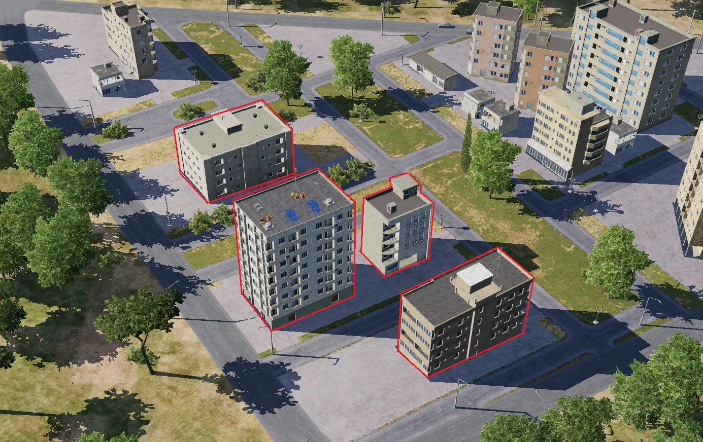
OPARTGT094 Syrian Intelligence Internet Agency DPIs
OPARTGT094A – 8 storey buildings made of concrete slab supported by reinforced concrete base and pillars, flat poured roof, requires delayed fuzing.
OPARTGT094B/C/D – 5 storey building, walls made of slabs, poured roof supported by metal frame and reinforced concrete pillars. Requires delayed fuzing.
Suggested fuzing solution on DPIs 1-4 – contact to open up the roof followed by delayed to pierce through floors and affect building structure.
N
OPARTGT094D
4
OPARTGT094B
1
1
2
OPARTGT094A
3
OPARTGT094C

